Slide 1

USER MANAGEMENT
Autori:
Damjan Prerad
Filip Adamović
Vedran Jovanović
Aleksej Avramović
Advanced Python Programing Course Decembar - 2023
Notes:
Damjan

Slide 2
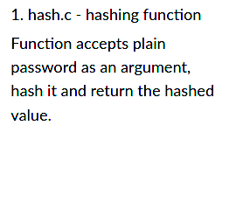
static PyObject* hash_password(PyObject* self, PyObject* args) {
const char *pass;
if (!PyArg_ParseTuple(args, "s", &pass)) {
return NULL;
}
char key[] = "thisisthekey";
char hashed_pass[MAX_PASSWORD_LENGTH + 1] = {0};
int pass_length = strlen(pass);
int key_length = strlen(key);
if (pass_length > MAX_PASSWORD_LENGTH) {
PyErr_SetString(PyExc_ValueError, "Password length exceeds maximum limit");
return NULL;
}
for (int i = 0; i < pass_length; ++i) {
hashed_pass[i] = pass[i] ^ key[i % key_length];
}
hashed_pass[pass_length] = '\0';
return Py_BuildValue("s", hashed_pass);
}
Notes:
Damjan

Slide 3
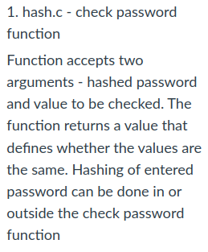
static PyObject* check_password(PyObject* self, PyObject* args) {
const char *hash, *pass;
if (!PyArg_ParseTuple(args, "ss", &hash, &pass)) {
return NULL;
}
char hashed_pass[MAX_PASSWORD_LENGTH + 1] = {0};
int pass_length = strlen(pass);
int key_length = strlen("thisisthekey");
if (pass_length > MAX_PASSWORD_LENGTH) {
PyErr_SetString(PyExc_ValueError, "Password length exceeds maximum limit");
return NULL;
}
for (int i = 0; i < pass_length; ++i) {
hashed_pass[i] = pass[i] ^ "thisisthekey"[i % key_length];
}
hashed_pass[pass_length] = '\0';
int match = strcmp(hash, hashed_pass);
if (match == 0) {
Py_RETURN_TRUE;
} else {
Py_RETURN_FALSE;
}
}
Notes:
Damjan

Slide 4
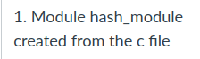
static PyMethodDef HashMethods[] = {
{"hash_password", hash_password, METH_VARARGS, "Returns hashed password."},
{"check_password", check_password, METH_VARARGS, "Checks if password matches hash."},
{NULL, NULL, 0, NULL}
};
static struct PyModuleDef hashmodule = {
PyModuleDef_HEAD_INIT,
"hash_module",
"Module for hashing passwords",
-1,
HashMethods
};
PyMODINIT_FUNC PyInit_hash_module(void) {
return PyModule_Create(&hashmodule);
}
Notes:
Damjan

Slide 5
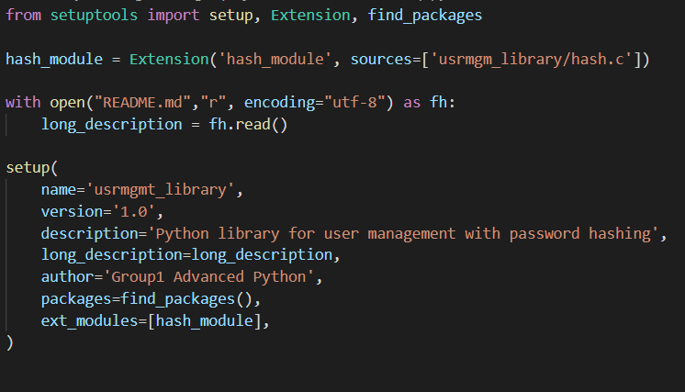
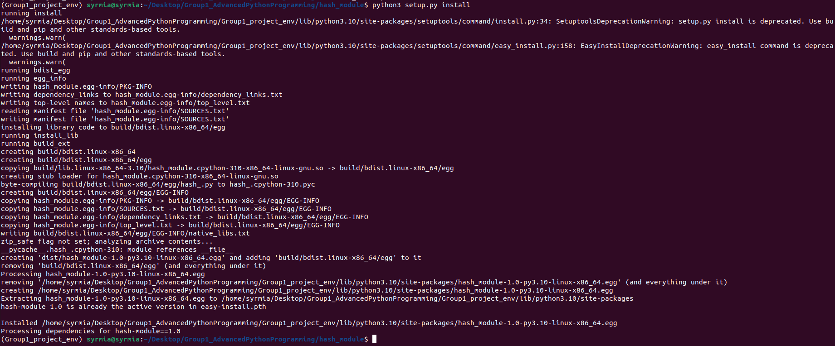
Setup.py
python3 setup.py install
Notes:
Damjan

Slide 6
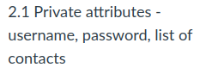
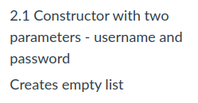
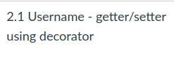
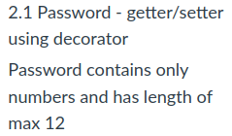
class User:
def __init__(self, username, password):
self._username = username
self._password = password#self._validate_password(password)-hashed password is already validated
self._contacts = []
@property
def username(self):
return self._username
@username.setter
def username(self, new_username):
self._username = new_username
@property
def password(self):
return self._password
@password.setter
def password(self, new_password):
self._password = hash_module.hash_password(self._validate_password(new_password))
def _validate_password(self, password):
if len(password) > 12 or not password.isdigit():
raise ValueError("Password must be numeric and have a maximum length of 12")
return password
Notes:
Vedran

Slide 7
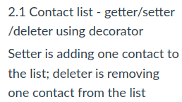
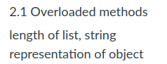
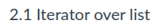
@contacts.setter
def contacts(self, contact):
self._contacts.append(contact)
@contacts.deleter
def contacts(self, index):
del self._contacts[index]
def __len__(self):
return len(self._contacts)
def __str__(self):
return f"User: {self._username}, Contacts: {self._contacts}"
def __iter__(self):
return iter(self._contacts)
Notes:
Vedran

Slide 8
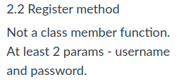
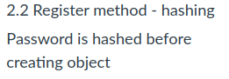
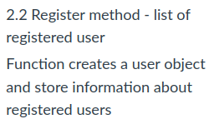
registered_users = {}
def validate_password(self, password):
if len(password) > 12 or not password.isdigit():
raise ValueError("Password must be numeric and have a maximum length of 12")
return password
def register(username, password):
if username in registered_users:
print(f"User '{username}' already exists. Please choose a different username.")
return None
hashed_password = hash_module.hash_password(validate_password(password))
user = User(username, hashed_password)
registered_users[username] = user
print(f"User '{username}' registered successfully.")
return user
Notes:
Vedran

Slide 9
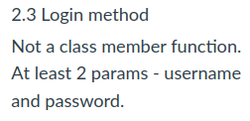
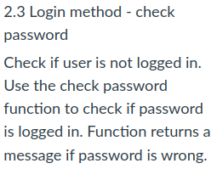
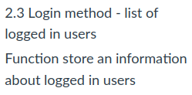
logged_in_users_lock = multiprocessing.Lock()
logged_in_users = []
def login(username, password):
with logged_in_users_lock:
if not username in registered_users:
print("Error: User is not registered. Please try again.")
return -1
user = registered_users[username]
if not hash_module.check_password(user.password, password):
print("Error: Incorrect password. Please try again.")
return -1
if username not in logged_in_users:
logged_in_users.append(username)
login_process = multiprocessing.Process(target=login_simulation, args=(username,logged_in_users))
login_process.start()
login_process.join()
else:
print(f"User {username} is already logged in.")
def login_simulation(username,logged_in_users):
time.sleep(1)
print(f"User {username} is logged in.")
Notes:
Vedran
Vedran
Vedran

Slide 10
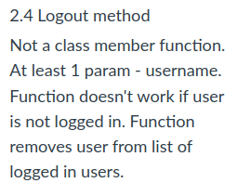
def logout(username):
with logged_in_users_lock:
if username in logged_in_users:
logged_in_users.remove(username)
print(f"User {username} is logged out.")
return 0
else:
print(f"User {username} is not logged in.")
return -1
Notes:
Vedran

Slide 11
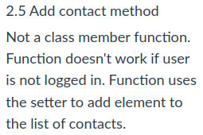
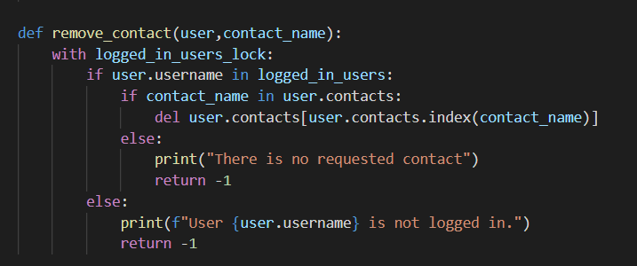
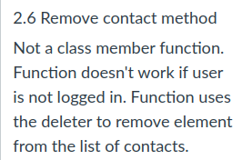
def add_contact(user,contact_name):
with logged_in_users_lock:
if user.username in logged_in_users:
if contact_name in user.contacts:
print("Contact already exists")
else:
user.contacts=contact_name
return None
else:
print(f"User {user.username} is not logged in.")
return -1
Notes:
Vedran

Slide 12
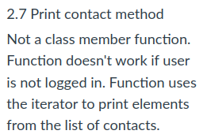
def print_contact(user):
with logged_in_users_lock:
if user.username in logged_in_users:
print(f"{user.username}'s contact list:")
for con in user.contacts:
print(con)
print(f"End of {user.username}'s contact list")
return None
else:
print(f"User {user.username} is not logged in.")
Notes:
Vedran

Slide 13
TESTING

Slide 14
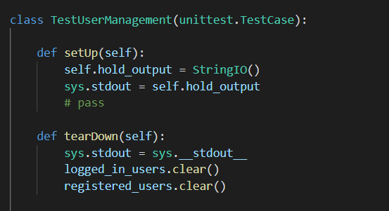
3.1 TestUserManagement class,
setUp() function is executed before each test.
tearDown() function is executed after each test. The function deletes all elements from the lists containing registered and online users.
Notes:
Filip

Slide 15
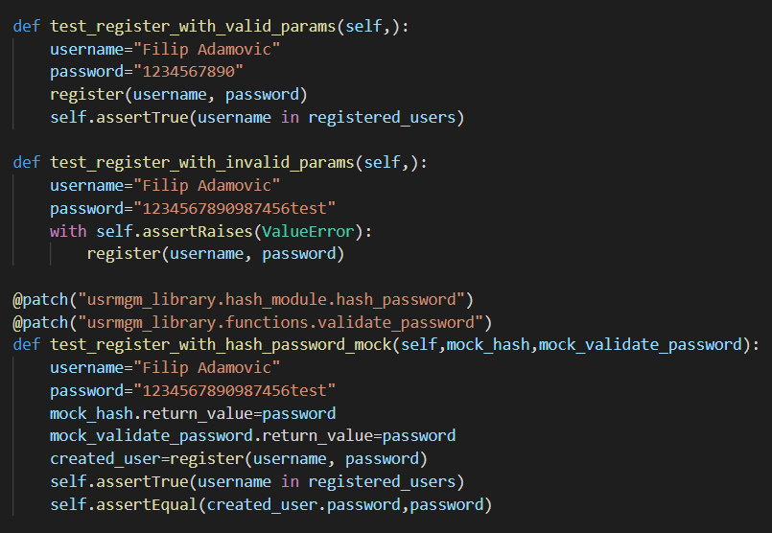
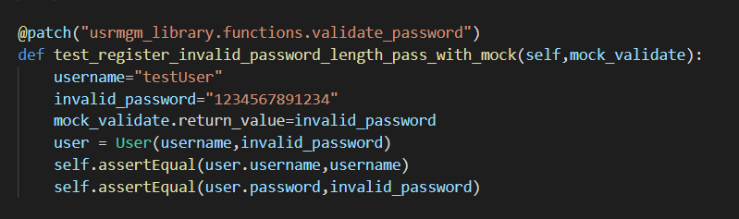
3.2 Tests for “register” function
Mocked functions hash_password(), validate_password()
Notes:
Filip

Slide 16
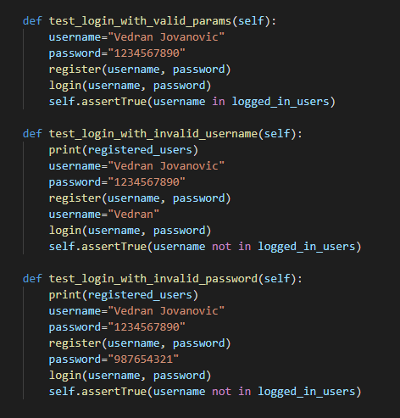
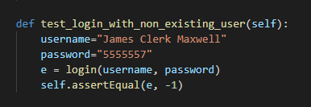
3.3 Tests for “login” function
Notes:
Filip

Slide 17
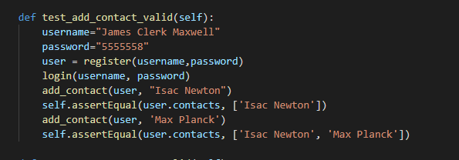
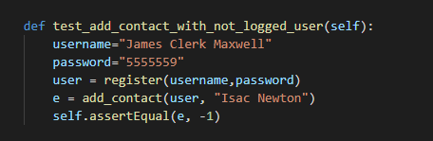
3.4 Tests for “add_contact” function
Notes:
Aleksej

Slide 18
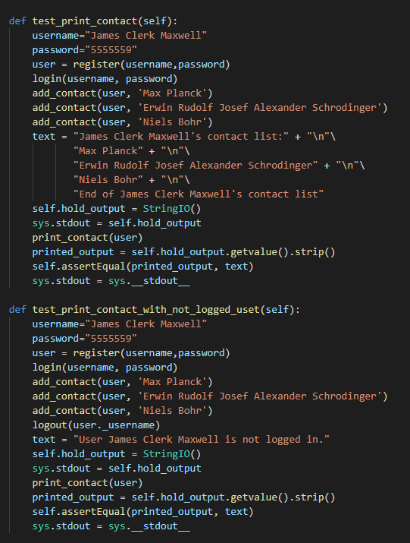
3.5 Tests for “print_contact” function
Notes:
Aleksej

Slide 19
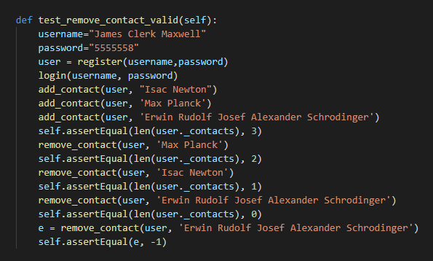
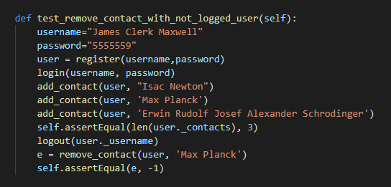
3.6 Tests for “remove_contact” function
Notes:
Aleksej

Slide 20
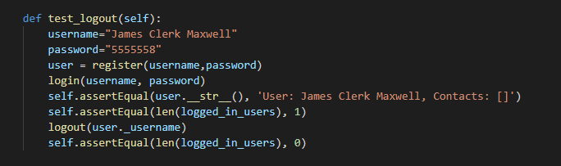
3.7 Tests for “logout” function
Notes:
Aleksej

Slide 21
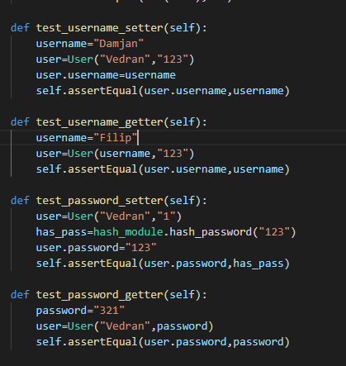
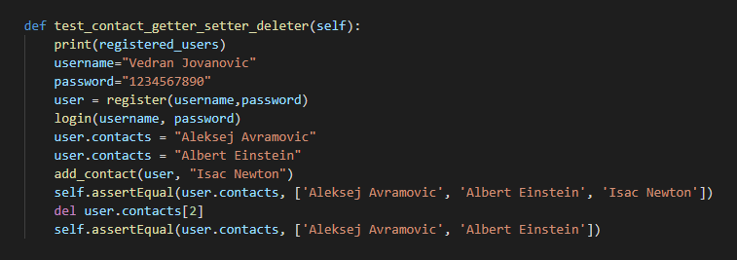
3.8 Tests for “getters/setters/deleter” functions
Notes:
Aleksej

Slide 22
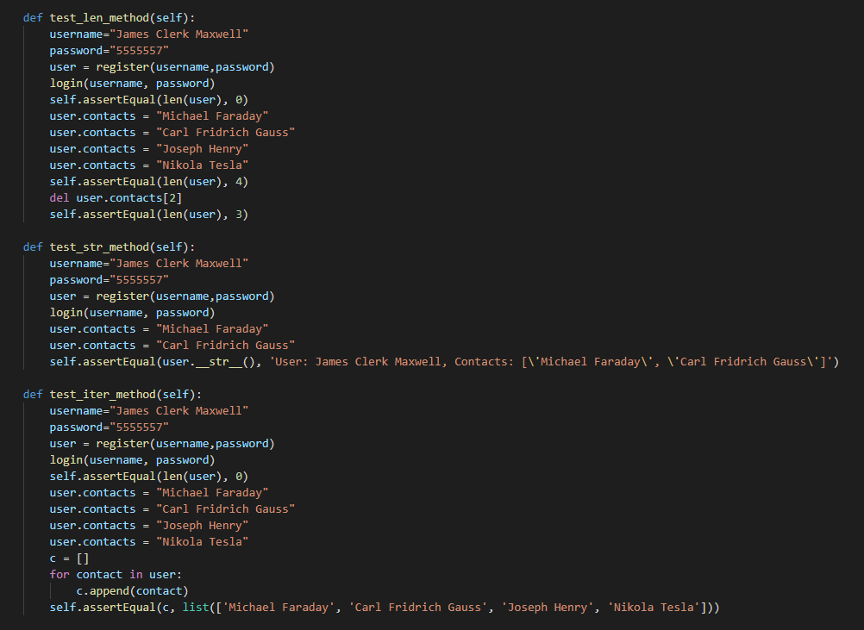
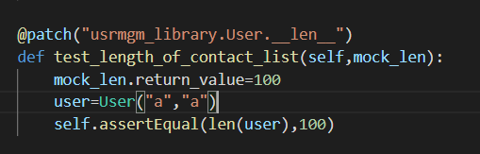
3.9 Tests for “__iter__, __len__, __str__” functions
Notes:
Aleksej

Slide 23
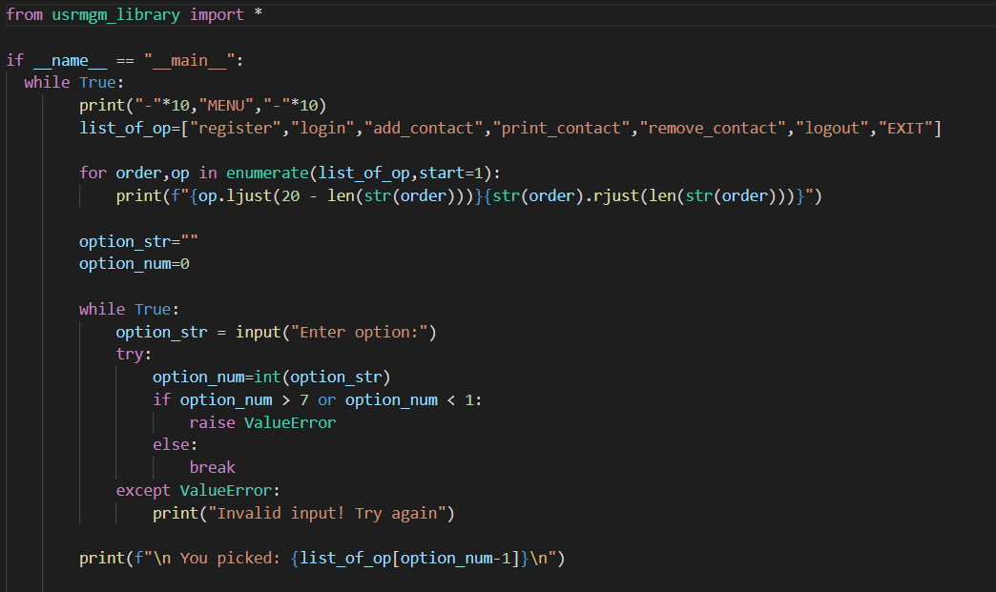
main.py
Menu items
Formatted menu printout
selecting a menu option
Notes:
Filip

Slide 24
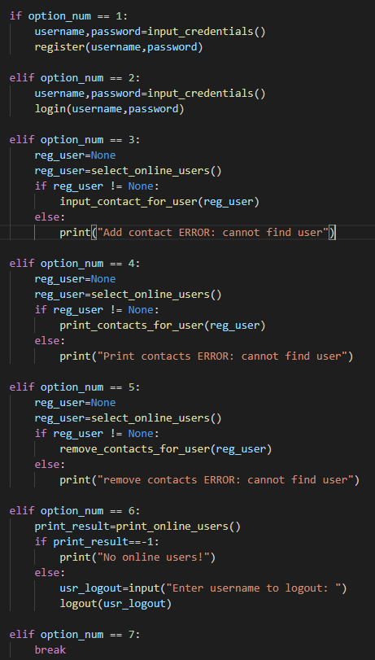
Register user
Login
Input contact for selected user
Print contact list for selected user
Remove contact from contact list for selected user
Logout
Exit the menu
Notes:
Filip

Slide 25
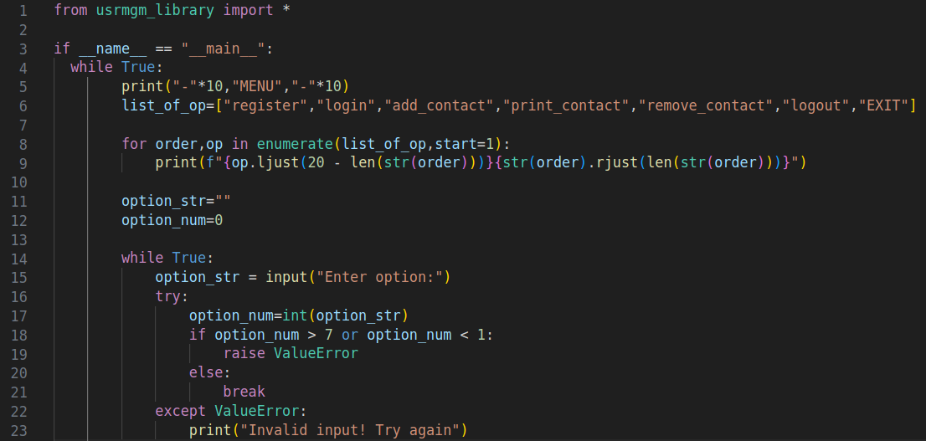
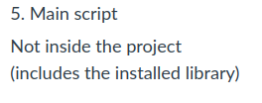
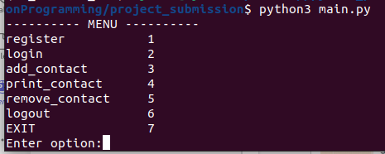
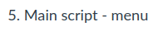
Import our library
Notes:
Filip

Slide 26
LIBRARY CREATION
Notes:
Damjan

Slide 27
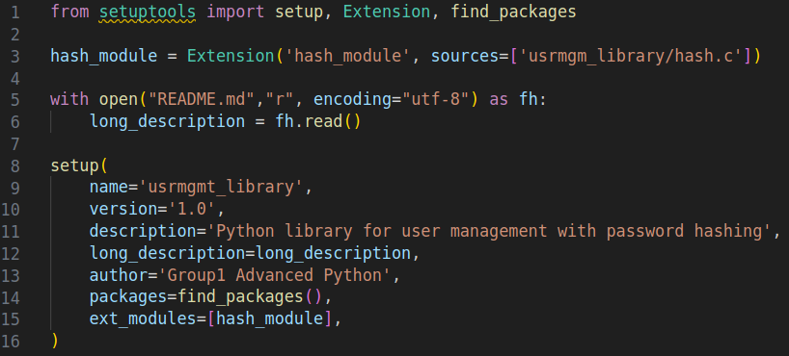
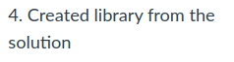
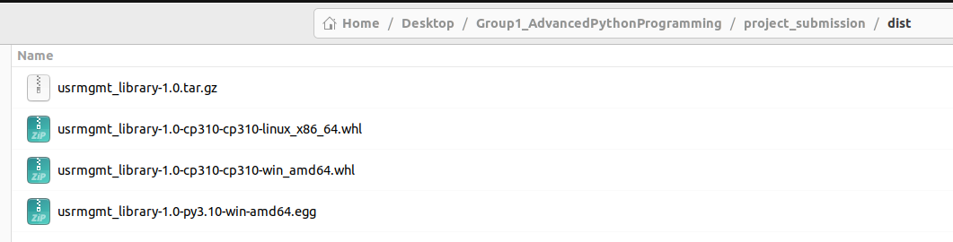
python3 setup.py build_ext --inplace
python3 setup.py install
python3 setup.py sdist bdist_wheel
Notes:
Damjan

